Slide 1

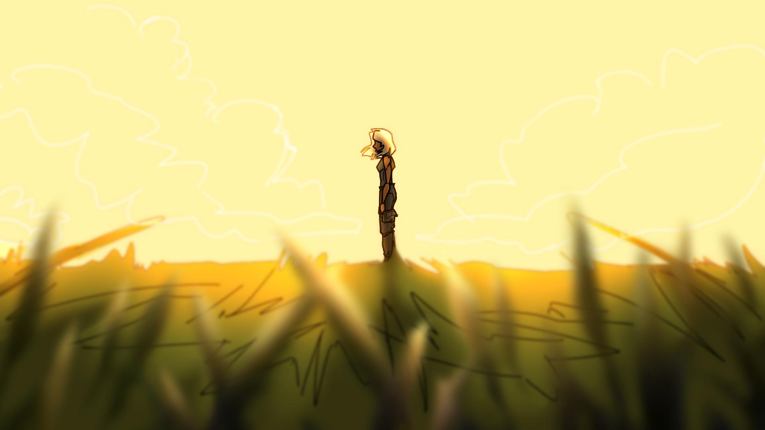
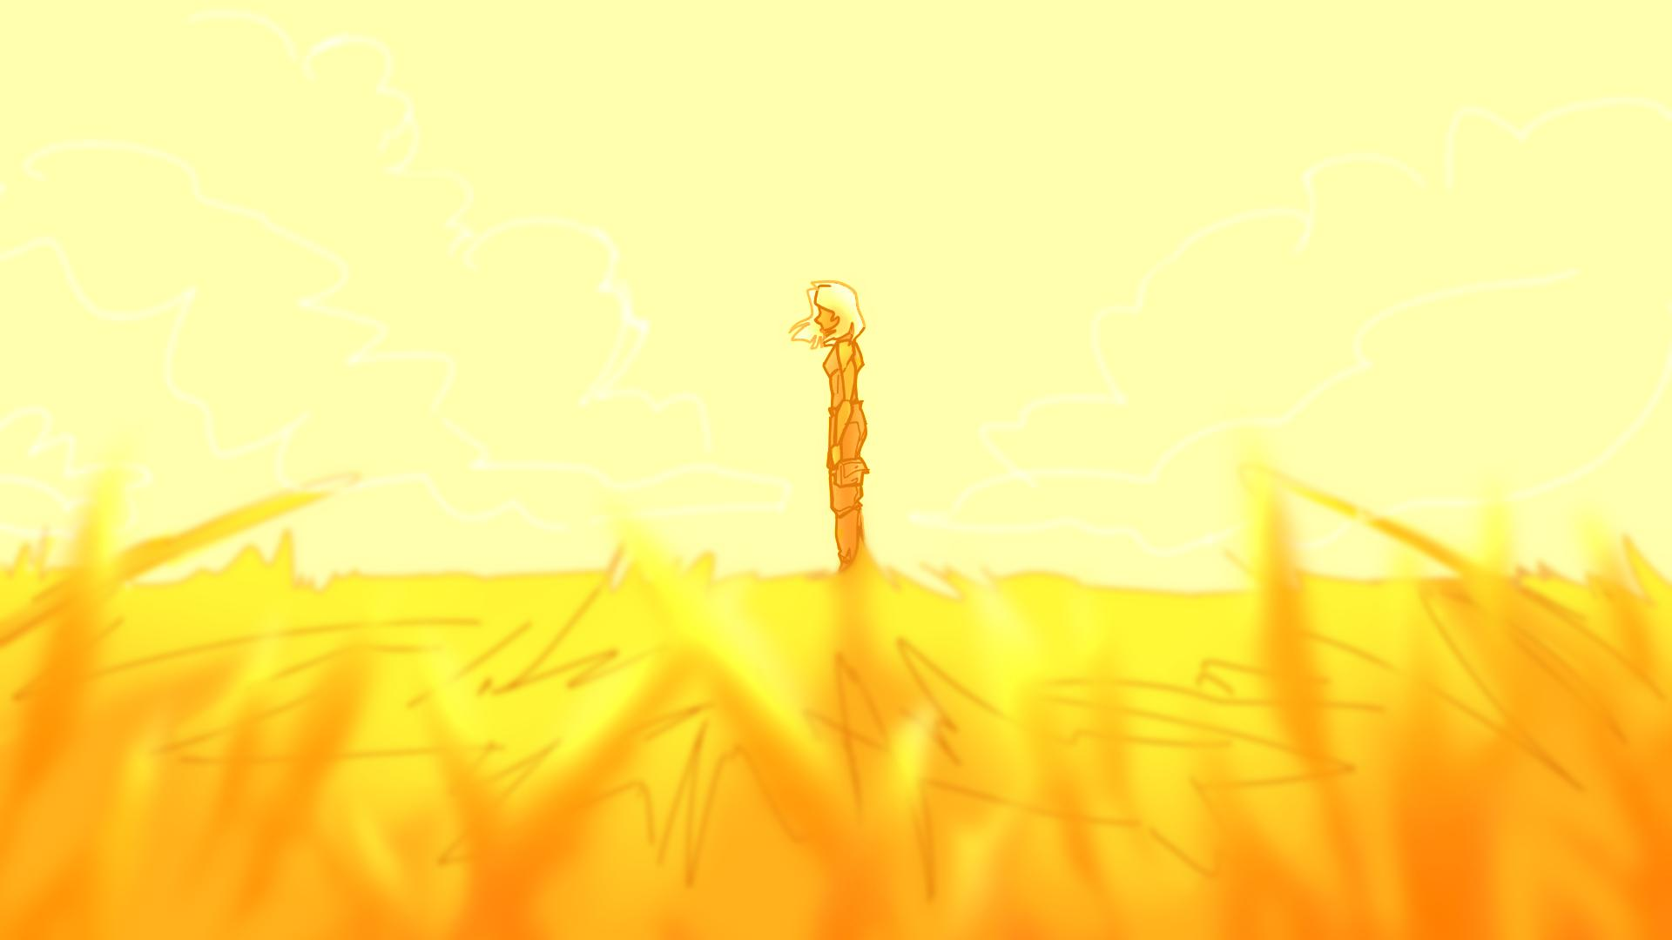


A short excerpt of a much longer story…
Music: The Great Sea by Scott Buckley

Slide 2
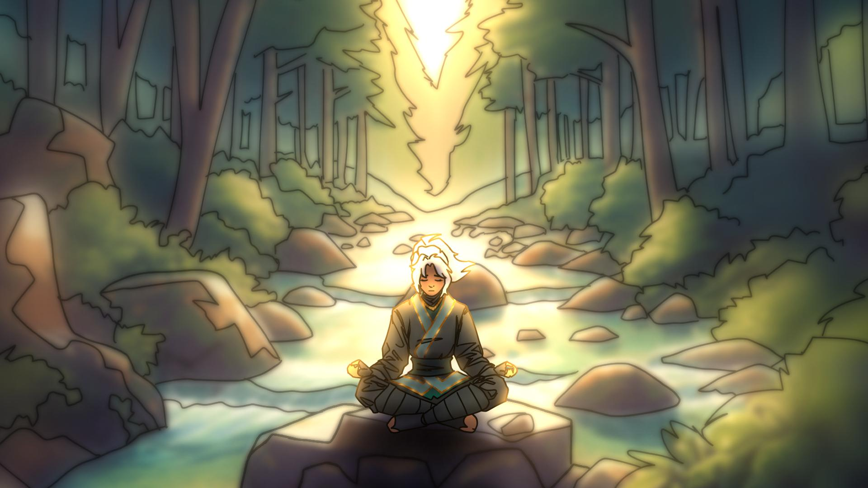
“I thought about the former days,
the years of long ago;
I remembered my songs in the night.
My heart meditated and my spirit asked:”

Slide 3
Kaijda Ilya Lamori…
The name I was born with…
My parents were
never much around…
They died when I was young… I don’t remember much about them…
I just go by Kaja now…
I tried to follow in their footsteps…
So much has happened since then…
But none of that could last forever…
I lost my sister too…
After everything, I reached my lowest…
I don’t know what’s become of my siblings…

Slide 4
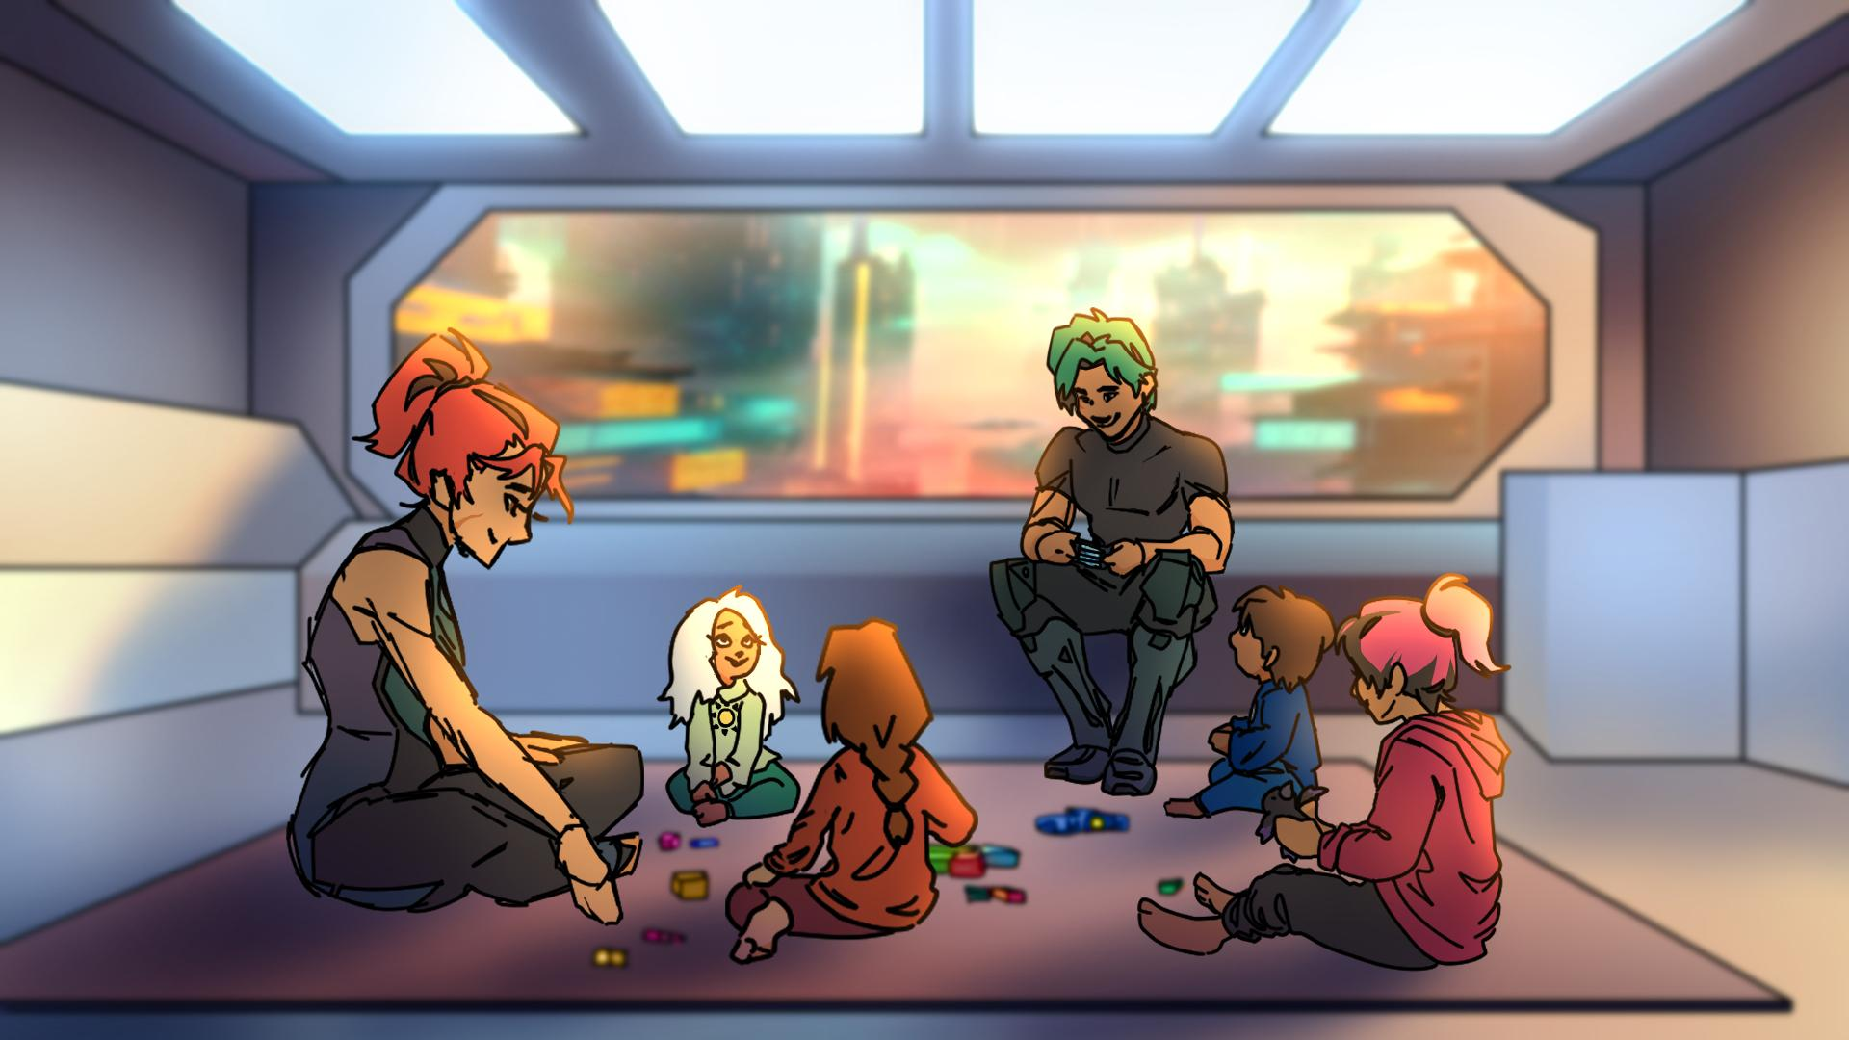
My parents were never much around…
Dad was great at fixing things, and making us laugh.
Mom always made sure to spend time with each of us.
They were always working so they could provide for us…

Slide 5
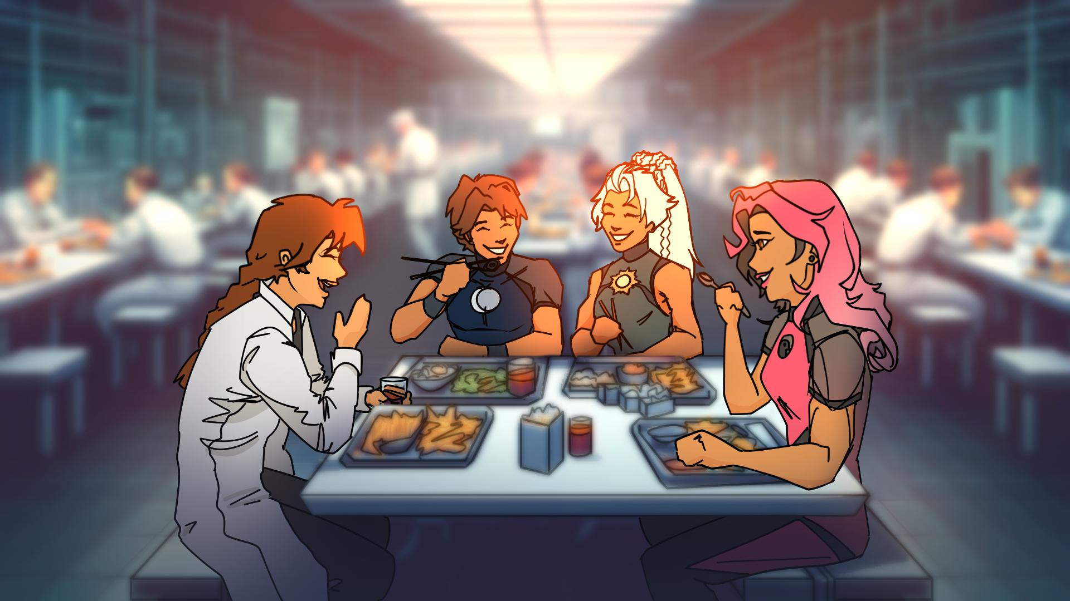
My parents died when I was young…
So I don’t remember much else…
Rey became like Dad to us… she made us laugh, and was always there to help fix things…
Wendi became like Mom, she was always there to listen when we needed it.
Dash and I were always close, being twins and all...

Slide 6
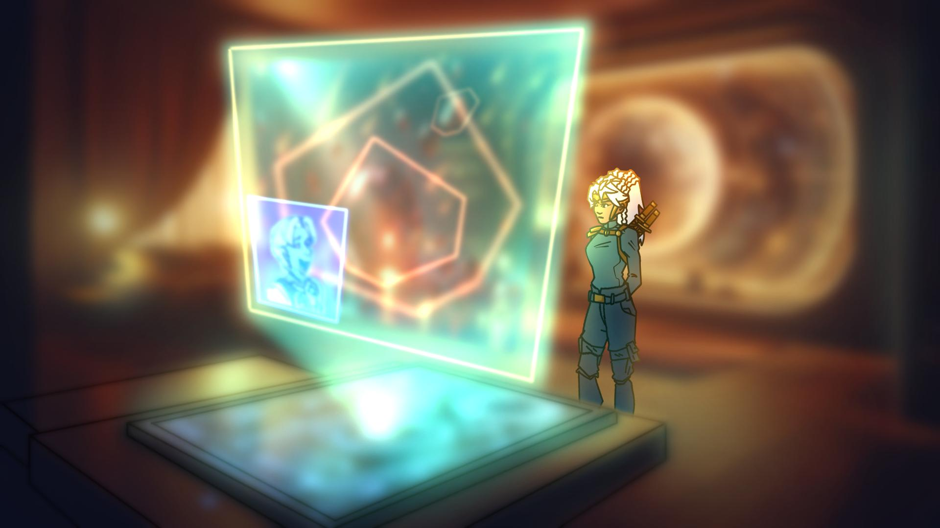
I tried to follow in their footsteps…
I trained for years…
Volunteering for even the most dangerous assignments…
And I loved it…

Slide 7
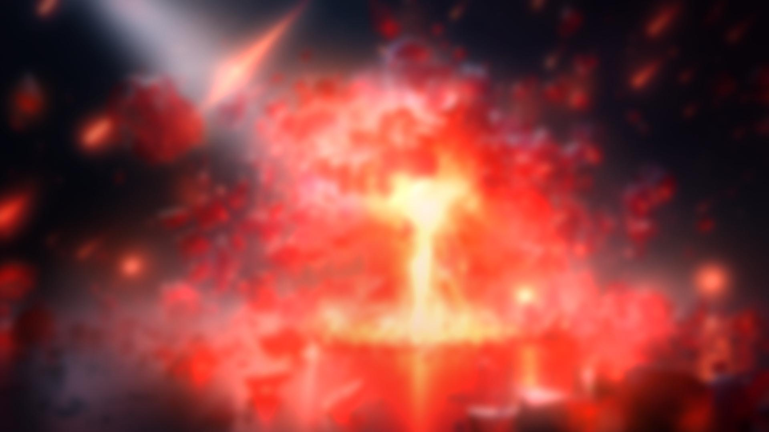



But none of that could last forever…
In the end…
We couldn’t stop the corruption…
They say everything has a season…

Slide 8
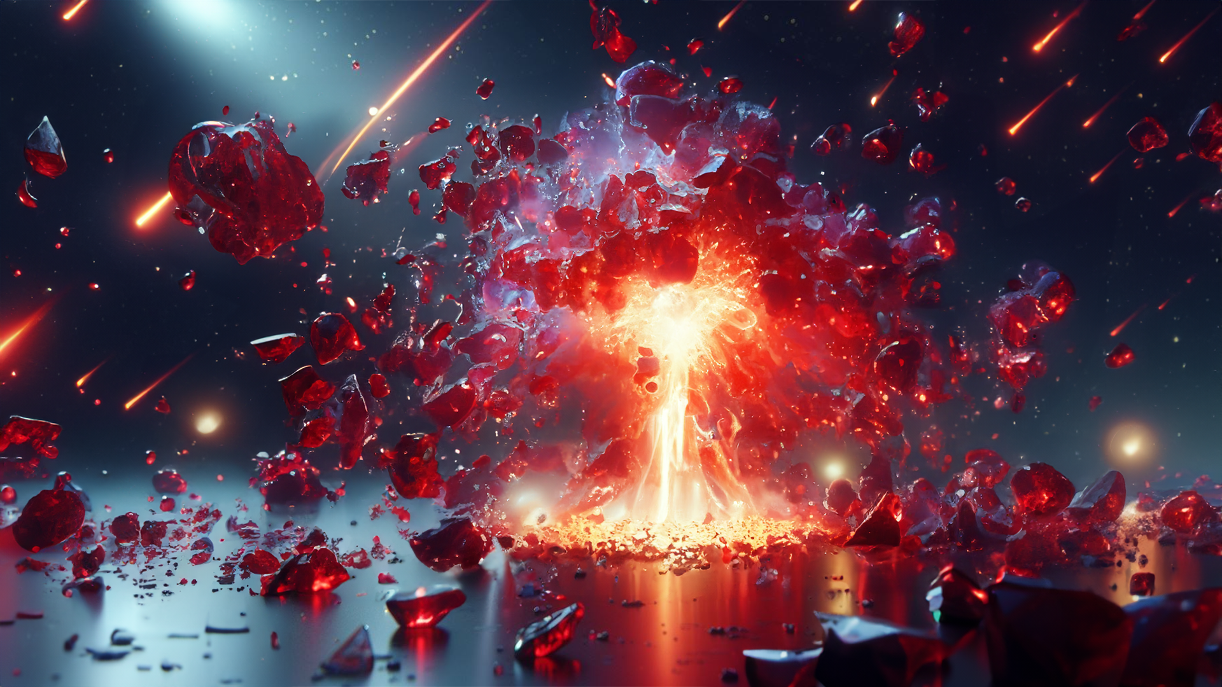
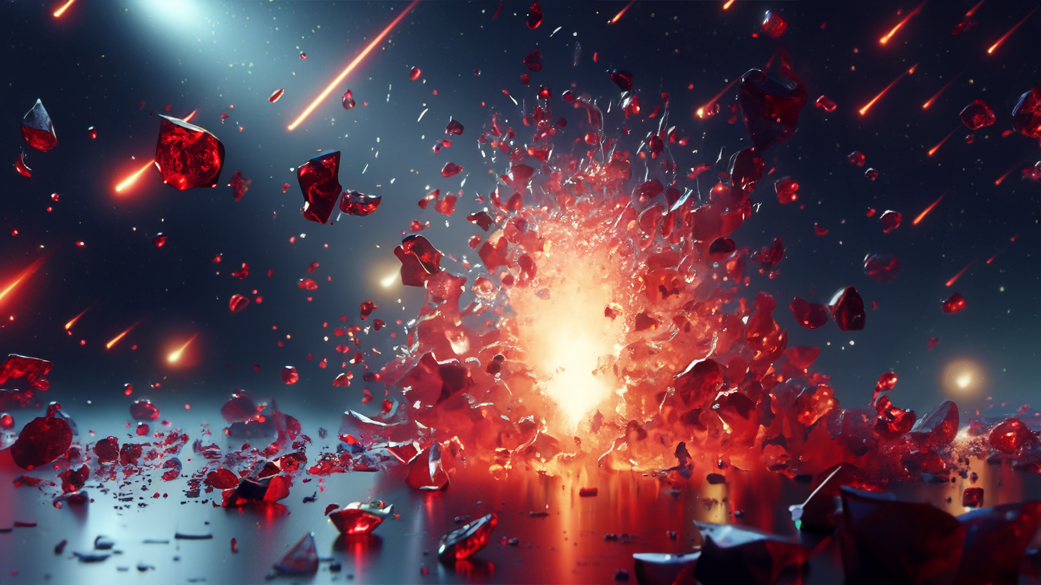
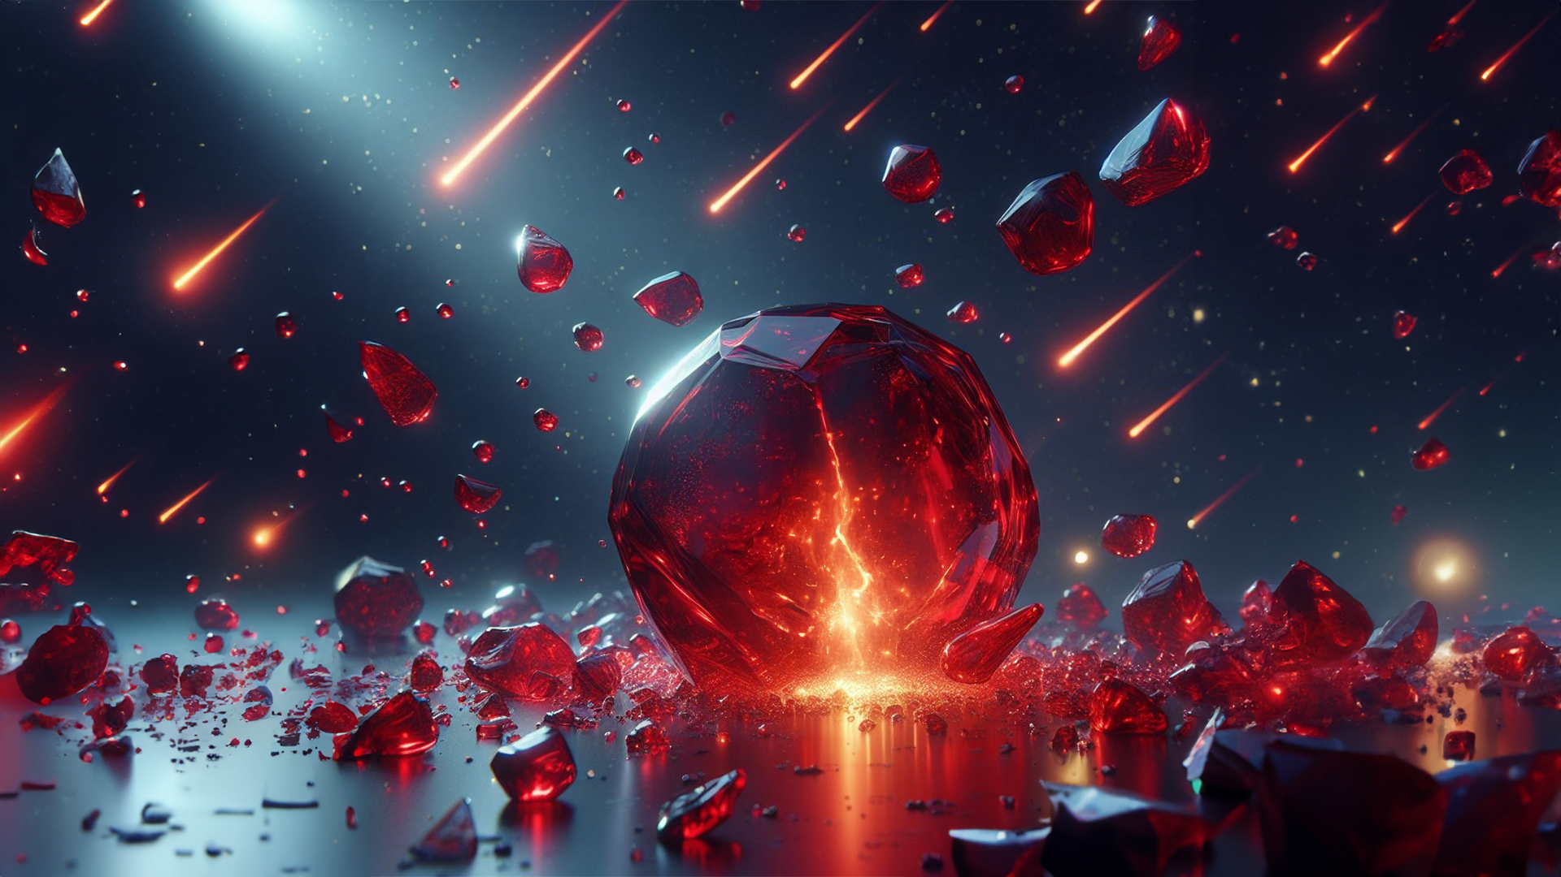
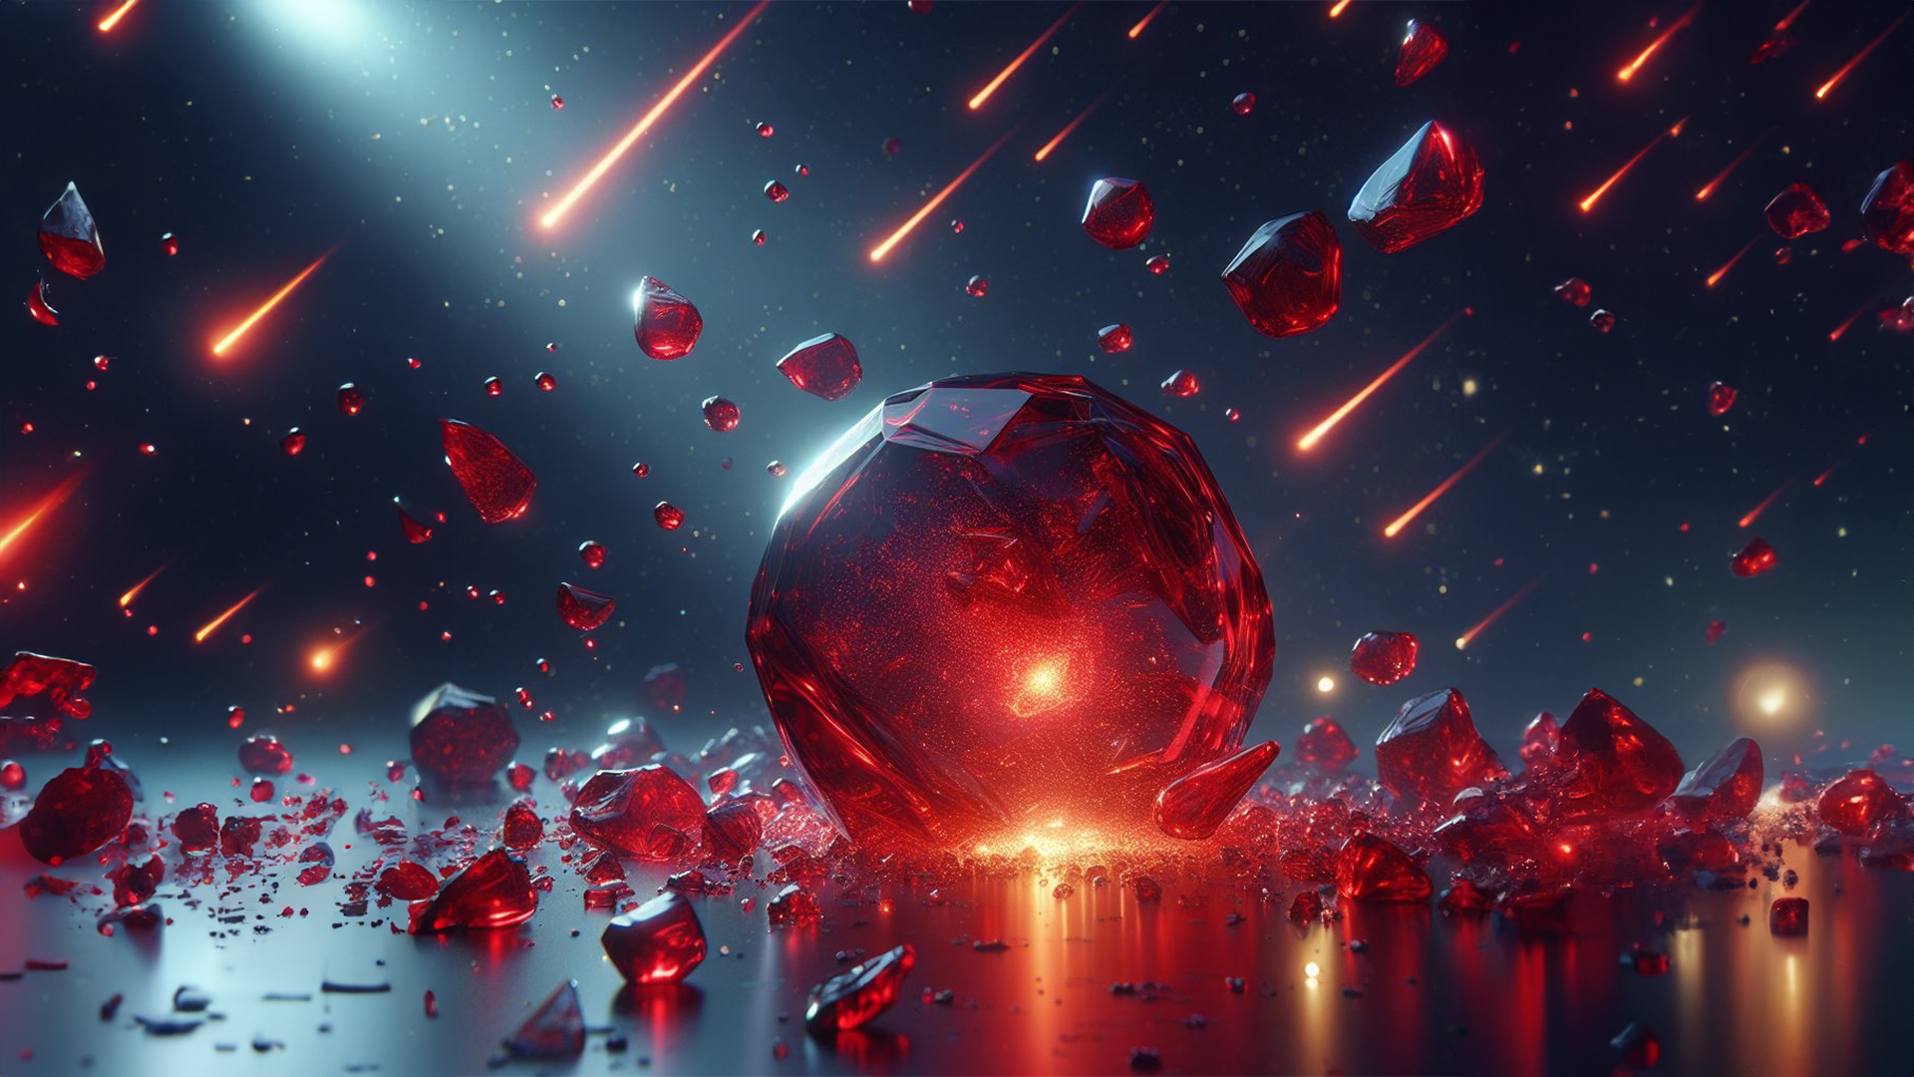

Slide 9
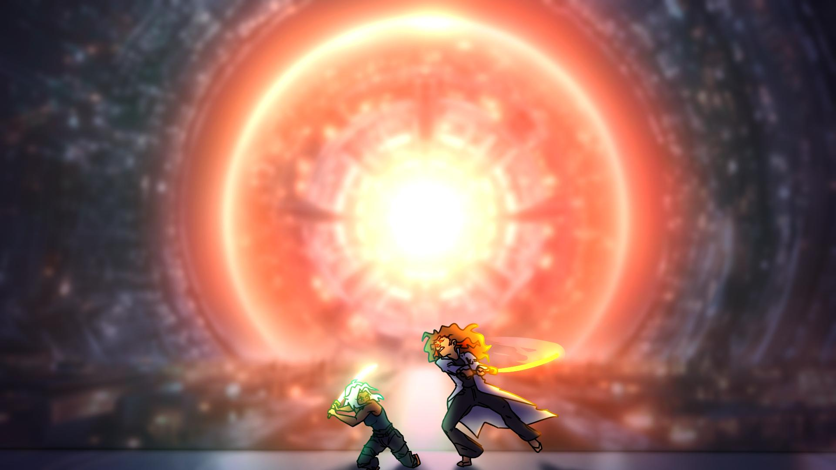
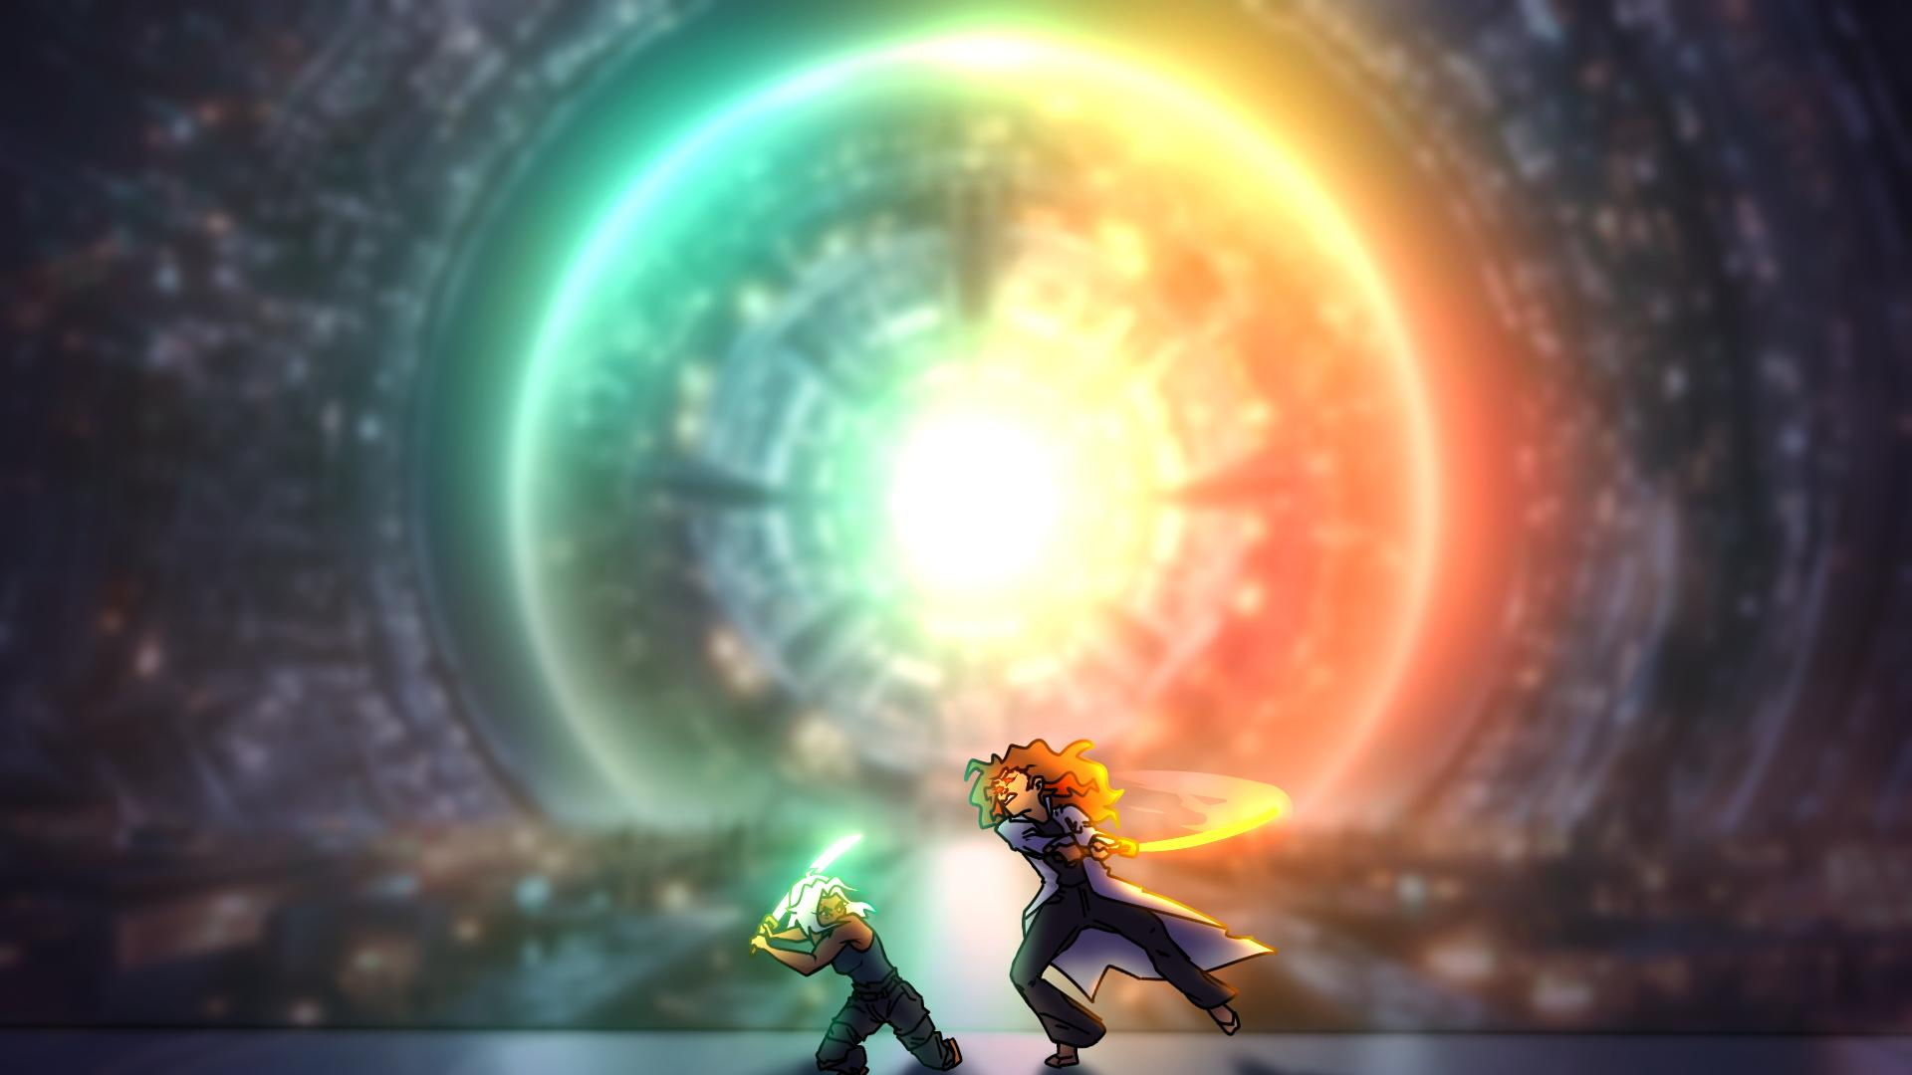
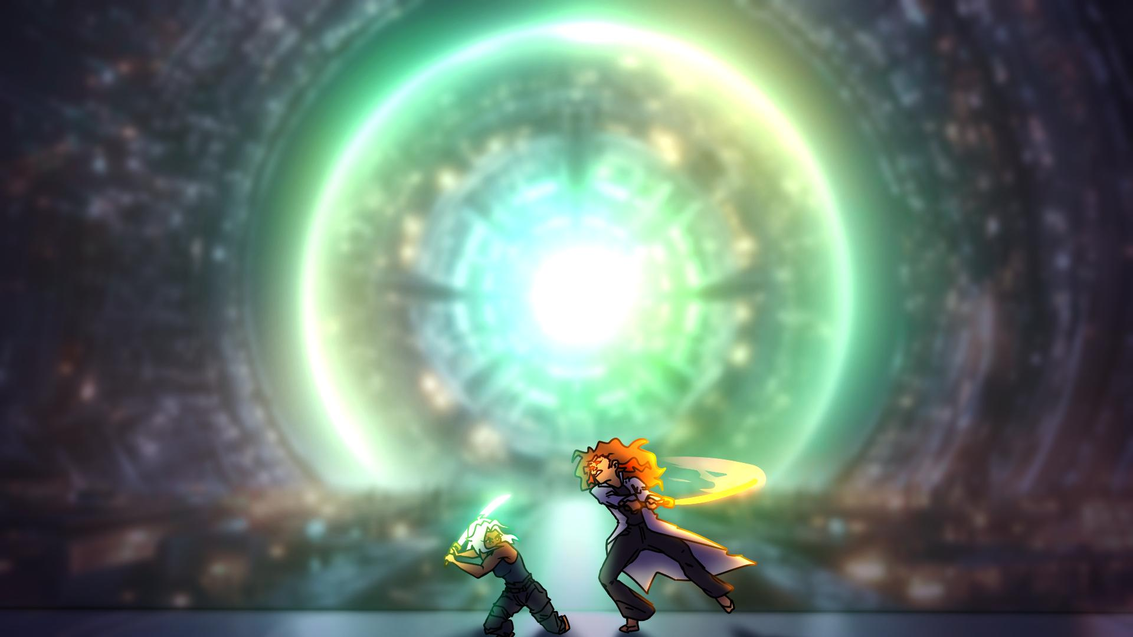
The corruption took Rowena too…
I should’ve seen the signs…
All I can do now is pray that she can still be saved…
I believe there’s hope for her yet…

Slide 10
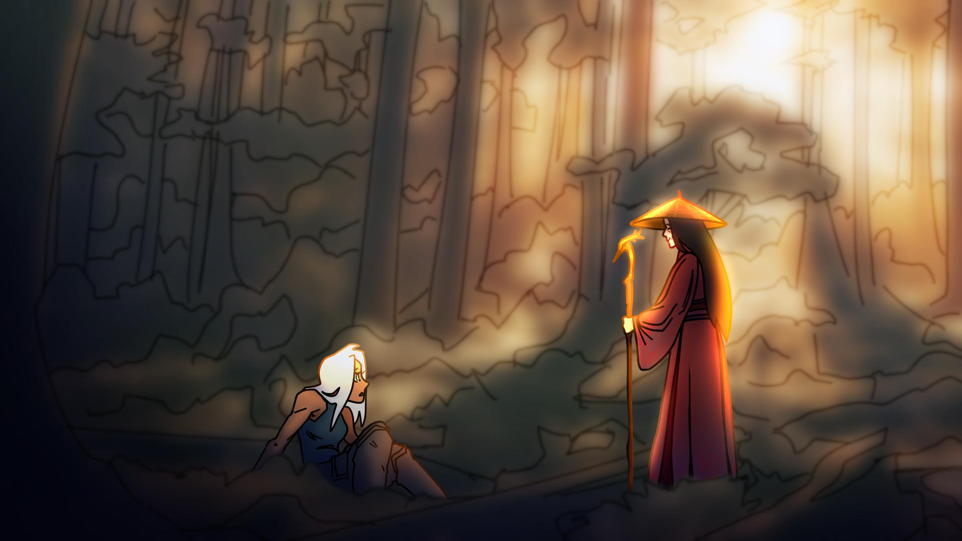
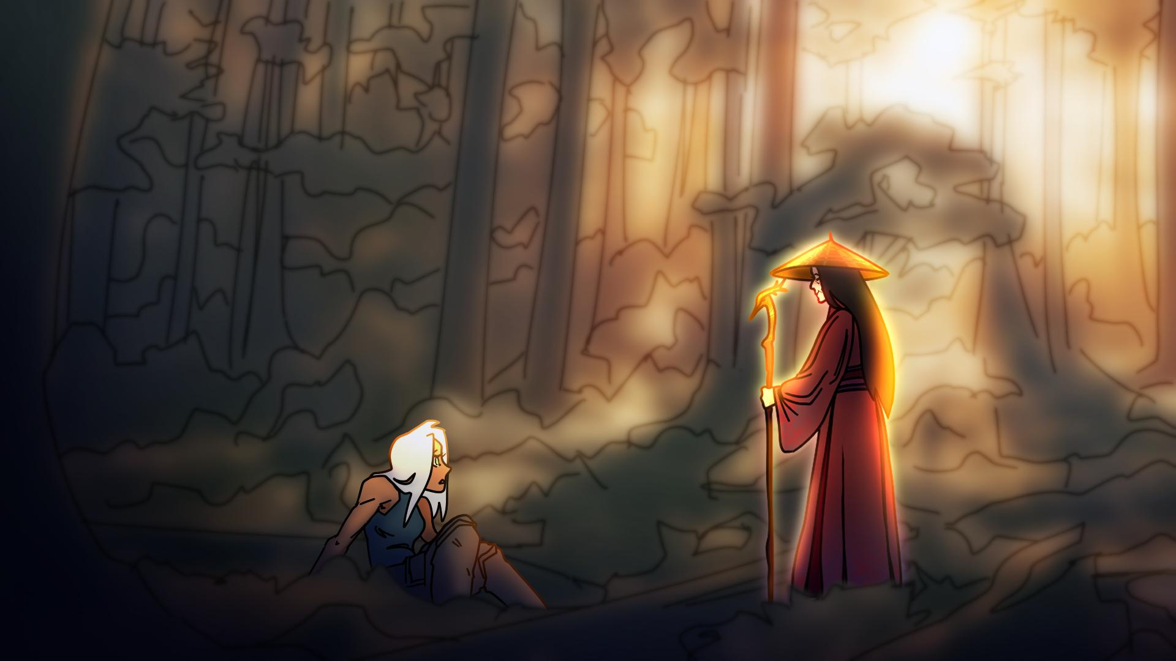
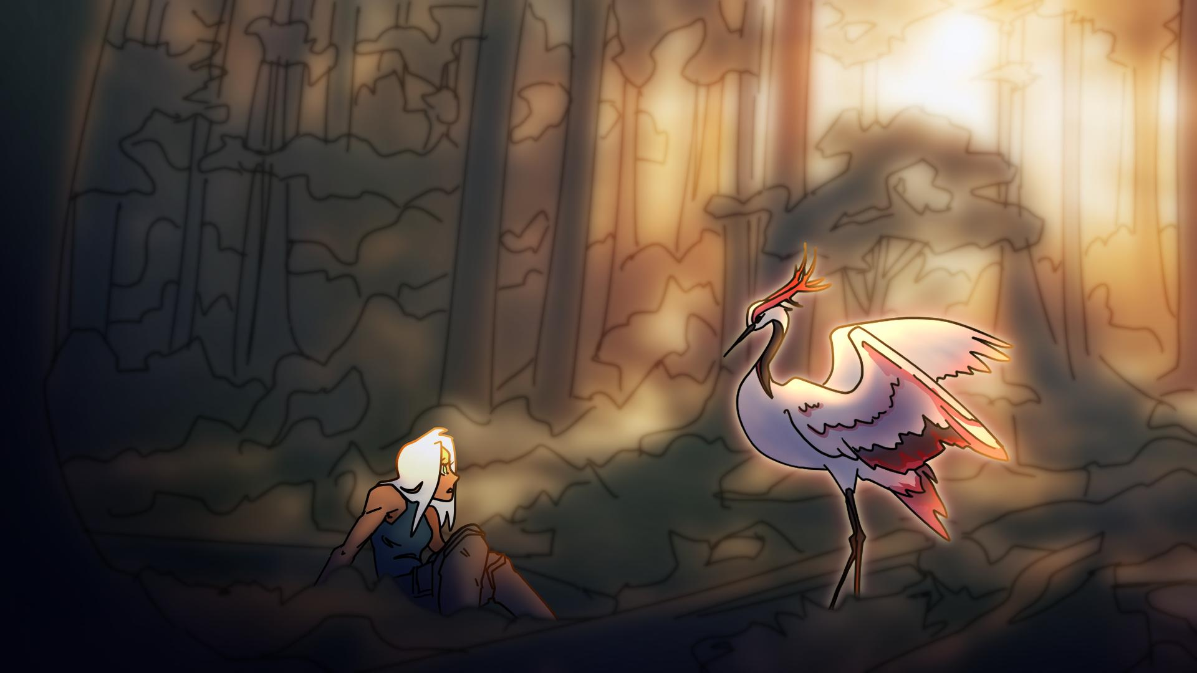
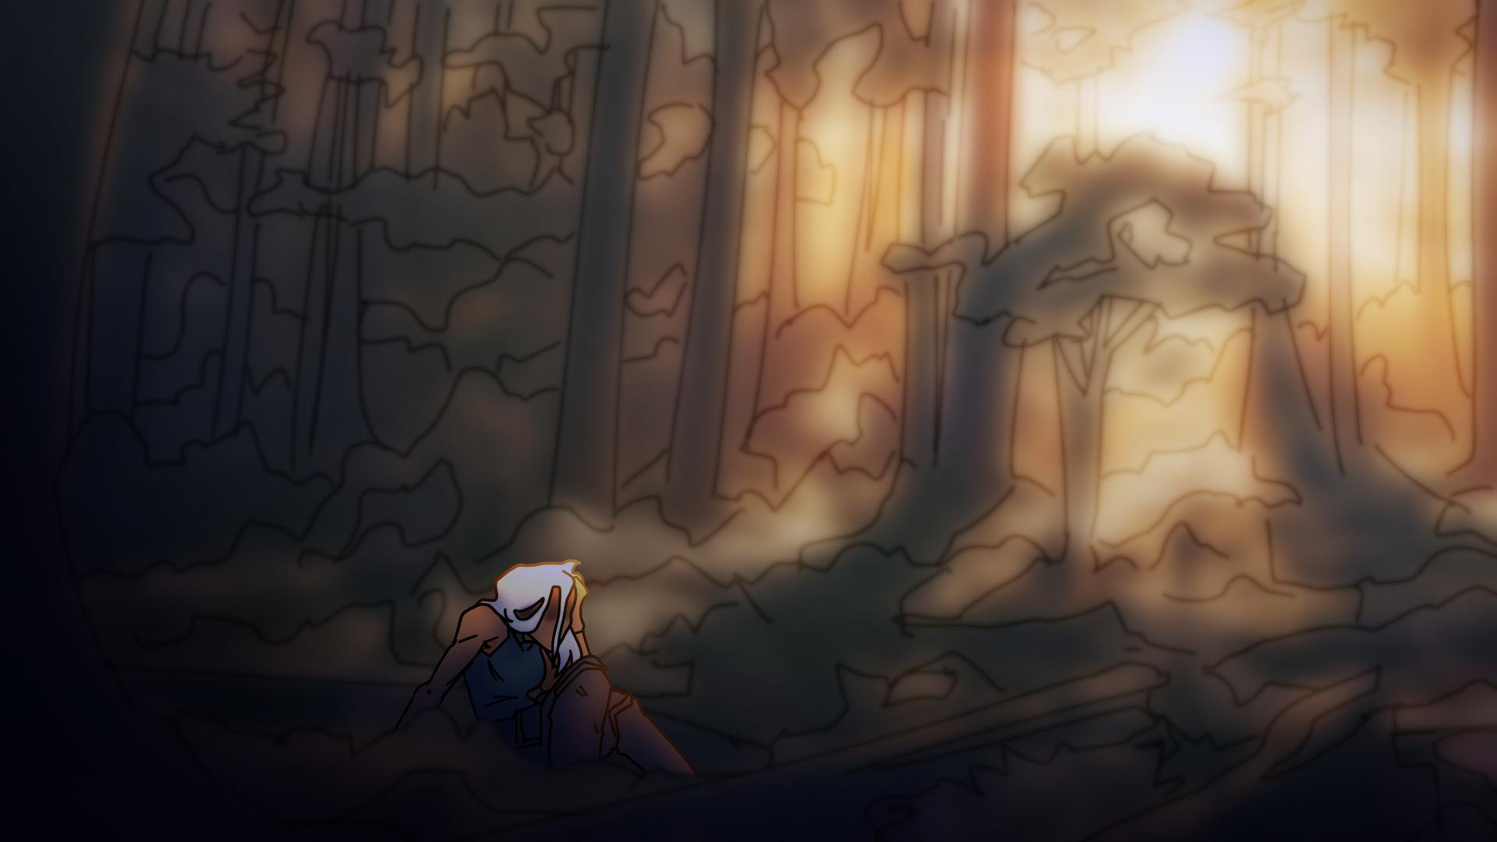
After everything… I was at my lowest.
Separated from my family…
I was all alone…
But not for long… I was lost, and now I’m found…
Now I’m improving every day…

Slide 11
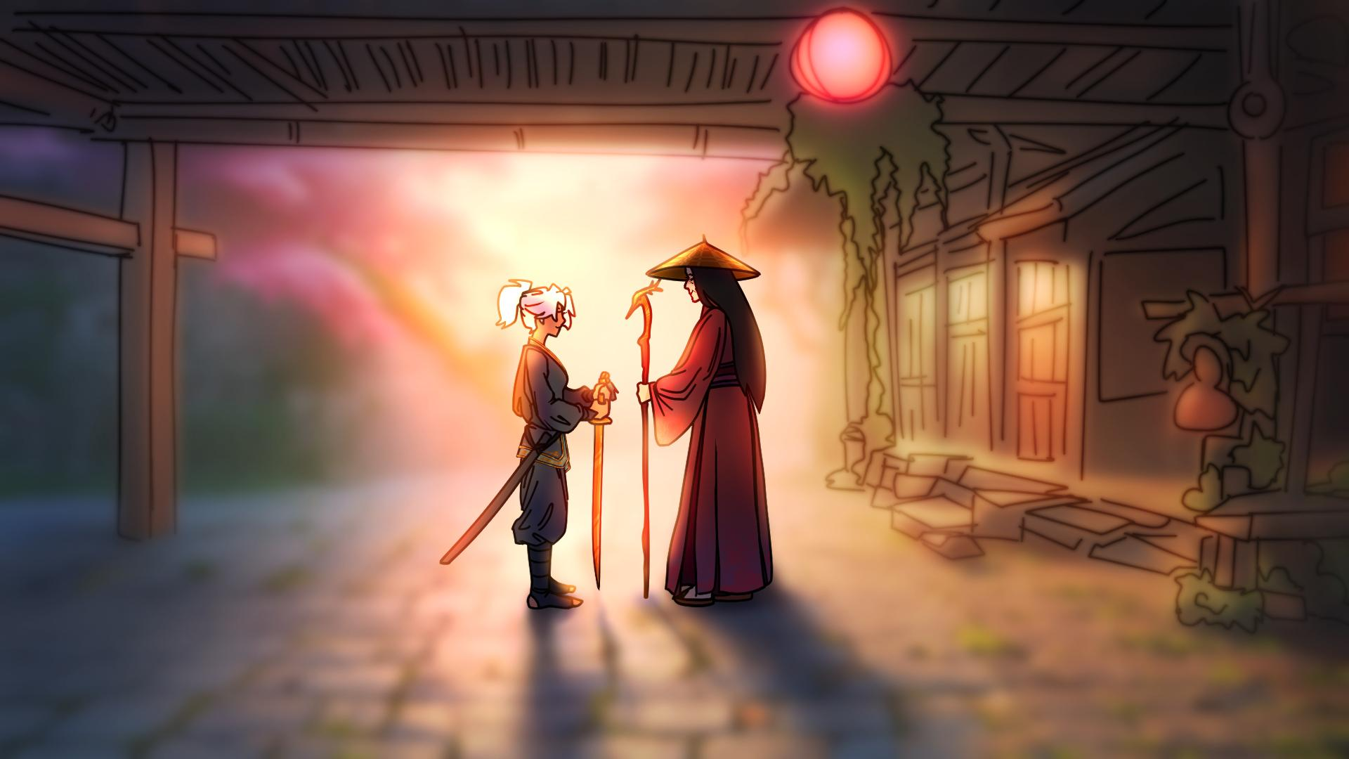
I don’t know what’s become of my siblings…
But I know I’ll find them again someday…
For now I have Lady Sakura…
She’s not quite family, but she’s the best kind of teacher.
“My heart meditated and my spirit asked:”

Slide 12
My parents were
never much around…
They died when I was young… I don’t remember much about them…
I tried to follow in their footsteps…
But none of that could last forever…
I lost my sister too…
After everything, I reached my lowest…
I don’t know what’s become of my siblings…

Slide 13
My parents were
always working
to provide for us…
But my siblings and I grew
closer because of that…
I loved continuing
their work…
Everything in life has a season…
Even the worst bits…
I still hold out hope for Wendi…
I’m improving every day…
“My spirit meditated and asked:”

Slide 14
“Will the Lord reject forever?
Will He never show His favor again?
Has His unfailing love vanished forever?
Has His promise failed for all time?
Has God forgotten to be merciful?
Has He in anger withheld His compassion?”

Slide 16
